Slide 1




M2Salesforce Backoffice

Slide 2
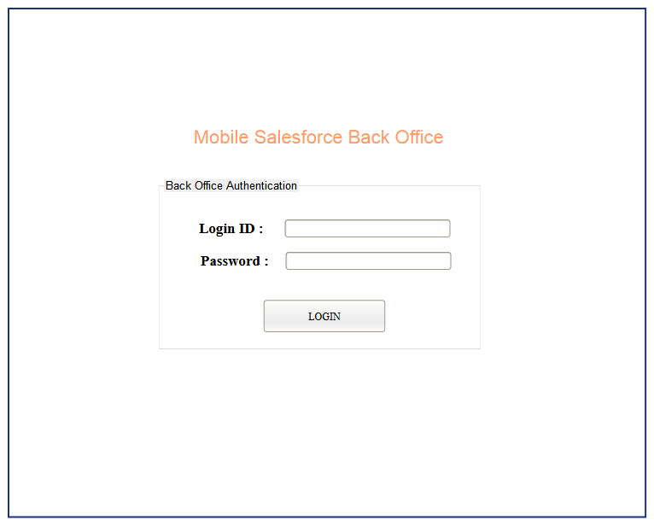
BO-001 (Login Screen)
Login Complete

Slide 3
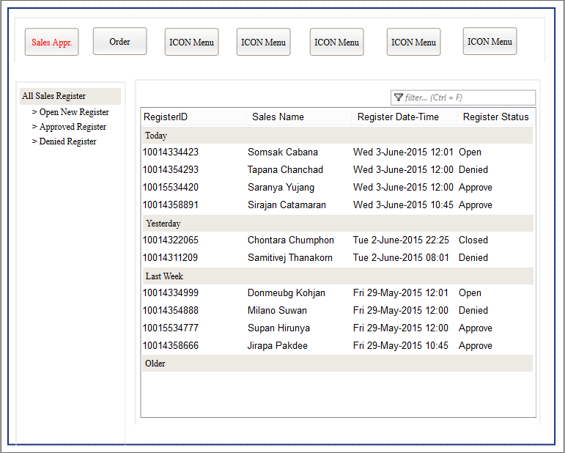
BO-A01 (SalesApprove1)
Open Sales Register Detail

Slide 4
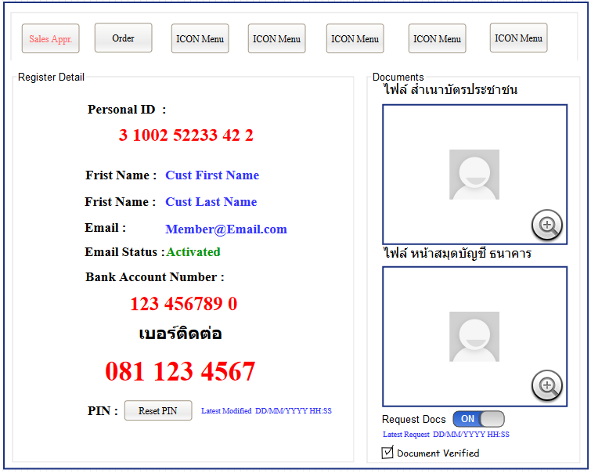
BO-A02 (SalesApprove2)

Slide 5
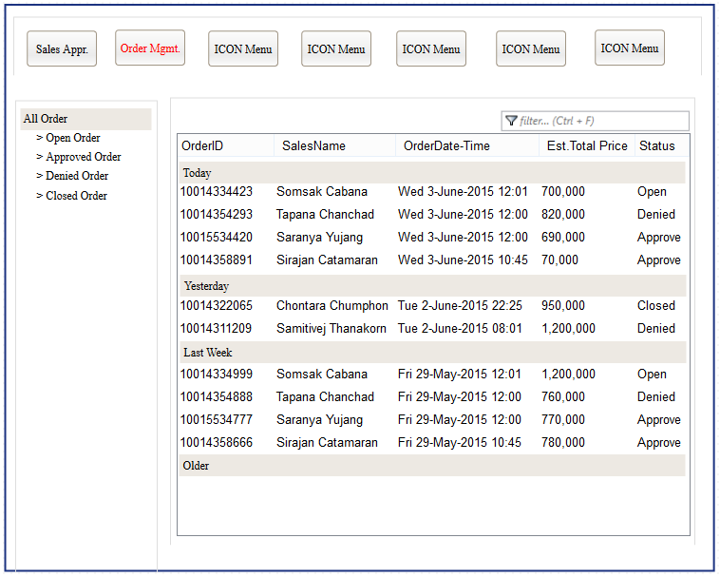
BO-T01 (OrderMgmt1)
Open Order Detail

Slide 6
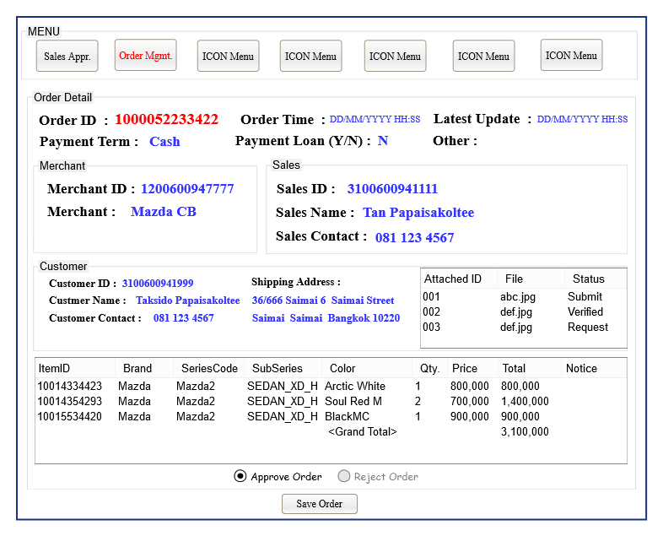
BO-T02 (OrderMgmt2)
Open Attached Detail

Slide 7
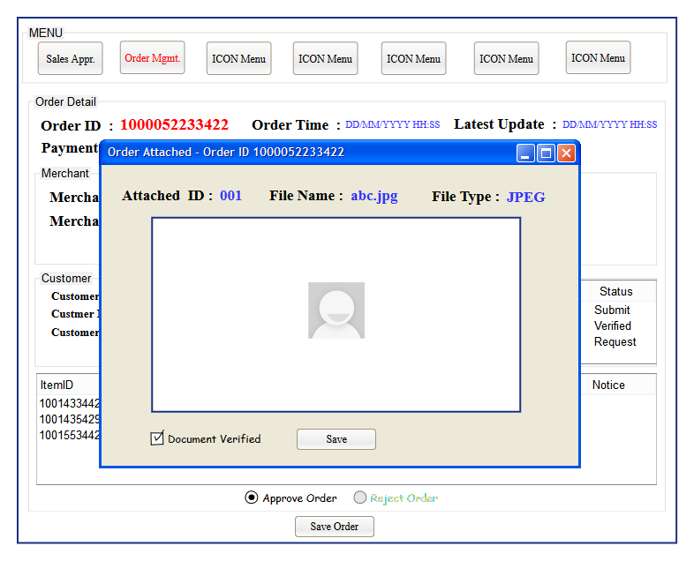
BO-T02 (OrderMgmt3)

